Slide 1

Efficient Execution of Transformers in RISC-V Vector Machines with Custom HW Acceleration
Integrated Systems Laboratory
Xiaorui Yin
Student:
Advisors: Matteo Perotti, Victor Jung (IIS)
Prof. Dr. Luca Benini
Renzo Andri (Huawei ZRC)
Master’s Thesis Aug. 2022
14. Feb. 2023

Slide 2
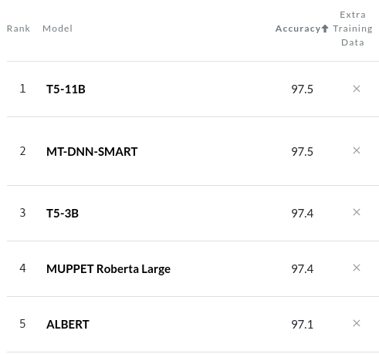
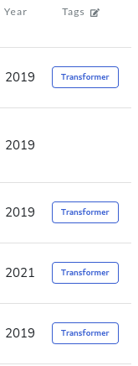


Transformer is Everywhere
1. From Natural Language Processing
SST-2 Binary classification
2. To Image Processing
Input
Attention
Introduction → Motivation → Background → Pre-Analysis → Implementation → Results → Conclusion
1. PaperWithCode, 2. by Jim Clyde Monge
3. Vision Transformer

Slide 3
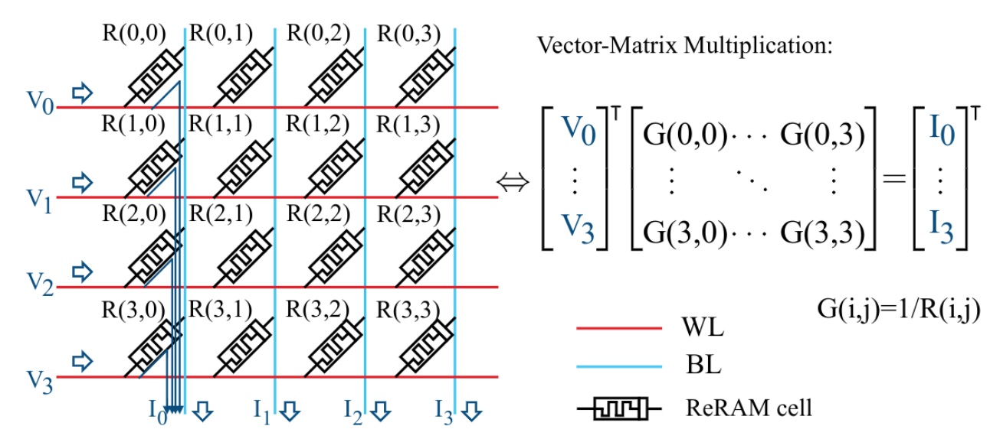
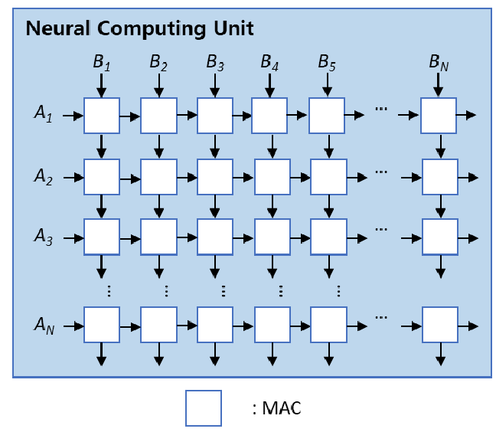
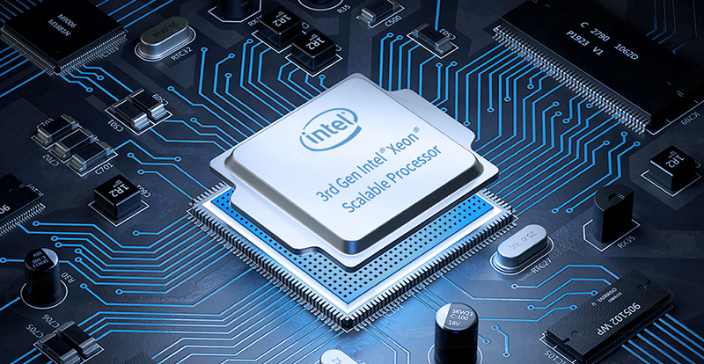
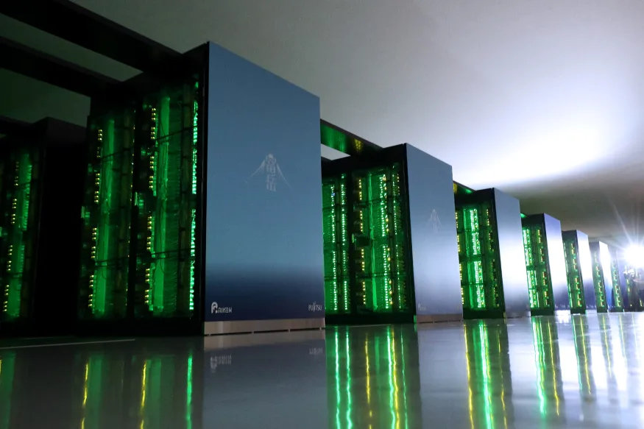
Transformer Accelerator
Systolic Array
Reuse data across one row/column
In-Memory-Computing
Performance
& Efficiency
Transformer is mainly composed of MatMul
Specialized Accelerators
Best performance & efficiency
Lack of flexibility (data precision, model, task)
DNNs evolve rapidly!
Supercomputer: Fugaku
Scalable Vector Extension (SVE)
General Purpose Processor
General Purpose Processors
Easily programmable
Flexible
Vector Processor
Parallel computing, SIMD
Popular in supercomputing
Ara + CVA6: RISC-V Vector Extension 1.0
Scalable: # lanes
Flexibility
Introduction → Motivation → Background → Pre-Analysis → Implementation → Results → Conclusion
1. Efficient Systolic-Array Redundancy Architecture for Offline/Online Repair
2. ReTransformer 3.https://www.engadget.com/japan-fugaku-supercomputer-013121699.html 4. FS community What Is a Server CPU?

Slide 4
Goal & Contribution
Goal:
Explore the capabilities and challenges of executing transformer on Ara (inference)
Optimize performance & efficiency (Software-Hardware)
Contribution:
Transformer vectorization and performance analysis
Improve small MatMul (new instructions, hardware)
Improve Transformer Performance & Efficiency
Introduction → Motivation → Background → Pre-Analysis → Implementation → Results → Conclusion

Slide 5
Background
Vector Processor: Ara
Transformer Model
Introduction → Motivation → Background → Pre-Analysis → Implementation → Results → Conclusion

Slide 6
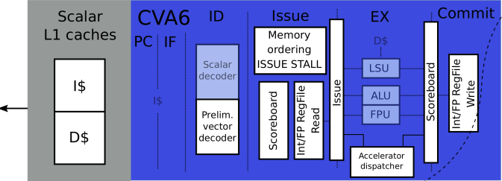
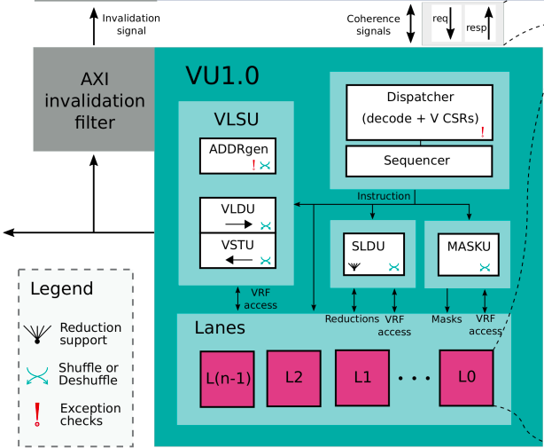
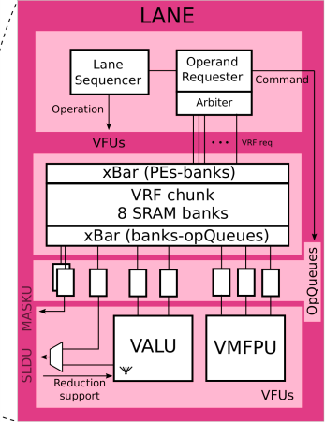
Vector Processor Ara
Scalar Core:
Send vector instructions to the vector unit
VRF:
Store a portion of the vector
1 lane, 1 FPU
VLSU:
memory ←→VRF
FPU Utilization ∝ Throughput
Introduction → Motivation → Background → Pre-Analysis → Implementation → Results → Conclusion
Notes:
一个简短的向量处理器以及Ara的介绍

Slide 7
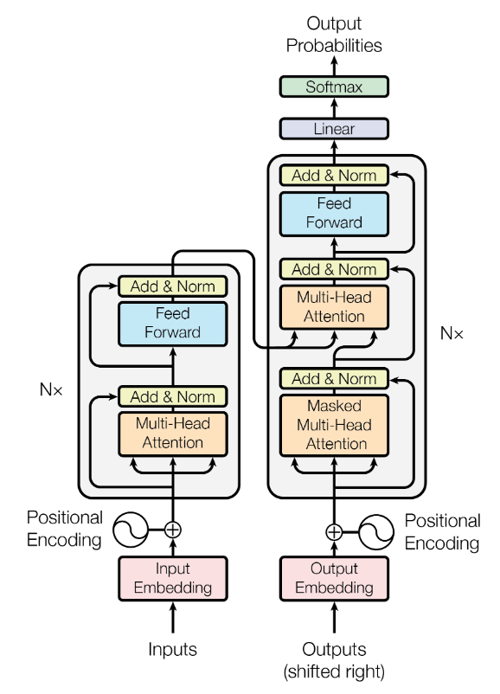
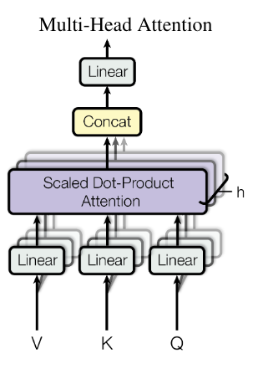
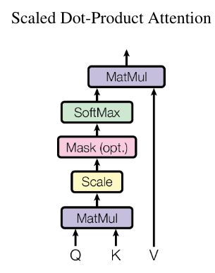
Transformer’s Architecture
Decoder
Encoder
Benchmark
Introduction → Motivation → Background → Pre-Analysis → Implementation → Results → Conclusion
Notes:
Transformer模型结构大致的介绍

Slide 8
Preliminary Analysis
Transformer Vectorization
Benchmark Evaluation
Introduction → Motivation → Background → Pre-Analysis → Implementation → Results → Conclusion

Slide 9
Transformer Vectorization: Multihead Attention
E x H*P
768x768
H x (S x P)
12x64x64
H x (P x E)
12x64x768
Wo
BERT model: H*P = E
Wq
MatMul
Bias
Q
H
S x E
64x768
S x E
64x768
Self-Attention
Self-Attention
K^T
Self-Attention
MatMul
Bias
Residual
Wk
MatMul
Bias
Transpose
Self-Attention
Dropout
LayerNorm
y
x
MatMul
Bias
Naming Convention from [1]
V
Wv
S | sequence length | 64~512
E | embedding size | 768~1280
H | # heads | 12~16
P | projection | 64~80
F | Feed Forward size | 3072~5120
S x P
64x64
Q(i)
S x S
64x64
S x S
64x64
MatMul
M1
Softmax
A
S x P
64x64
K(i)^T
MatMul
M2
Introduction → Motivation → Background → Pre-Analysis → Implementation → Results → Conclusion
[1]: MCU is all you need
V(i)

Slide 10
Transformer Vectorization: Multihead Attention
weight matrix (E x E)
768x768
Wo
h
Output to Feed Forward (S x E)
64x768
Multicore System:
Split Wq/Wk/Wv
Calculate Q(i), K(i), V(i) of each head individually
Self-Attention
Self-Attention
Self-Attention
MatMul
Bias
Residual
Self-Attention
Dropout
LayerNorm
y
E 768
Wq
Wq(0)
Wq(1)
Wq(2)
Wq(3)
E
768
…
P 64
S x P
768x64
S x P
64x64
Wq(i)
MatMul
Bias
Q(i)
S x S
64x64
S x S
64x64
MatMul
M1
Softmax
A
S x E
64x768
Wk(i)
K(i)^T
S x P
64x64
MatMul
Bias
Transpose
x
MatMul
M2(i)
Wv(i)
MatMul
Bias
V(i)
Introduction → Motivation → Background → Pre-Analysis → Implementation → Results → Conclusion

Slide 11
Transformer Vectorization: Feed Forward
E x F
768x3072
F x E
3072x768
W1
W2
N x F
64x3072
N x E
64x768
MatMul
Bias
y’
MatMul
Bias
Residual
ReLU
Dropout
LayerNorm
O
N x E
64x768
y
Introduction → Motivation → Background → Pre-Analysis → Implementation → Results → Conclusion

Slide 12
Transformer Vectorization: Individual Kernels
Memory
ReLU & Dropout:
x = 0 if x < 0 or based on a probability (mask)
vl_app = row * col
vl = min(vlmax, vl_app)
vec 1
vec 2
vec 3
vec 4
Softmax & LayerNorm:
Elements in a row are dependent
Load column for parallelization (strided load/store)
vl_app = row
vec 1
vec 2
vec 3
vec 4
vec 5
Introduction → Motivation → Background → Pre-Analysis → Implementation → Results → Conclusion

Slide 13
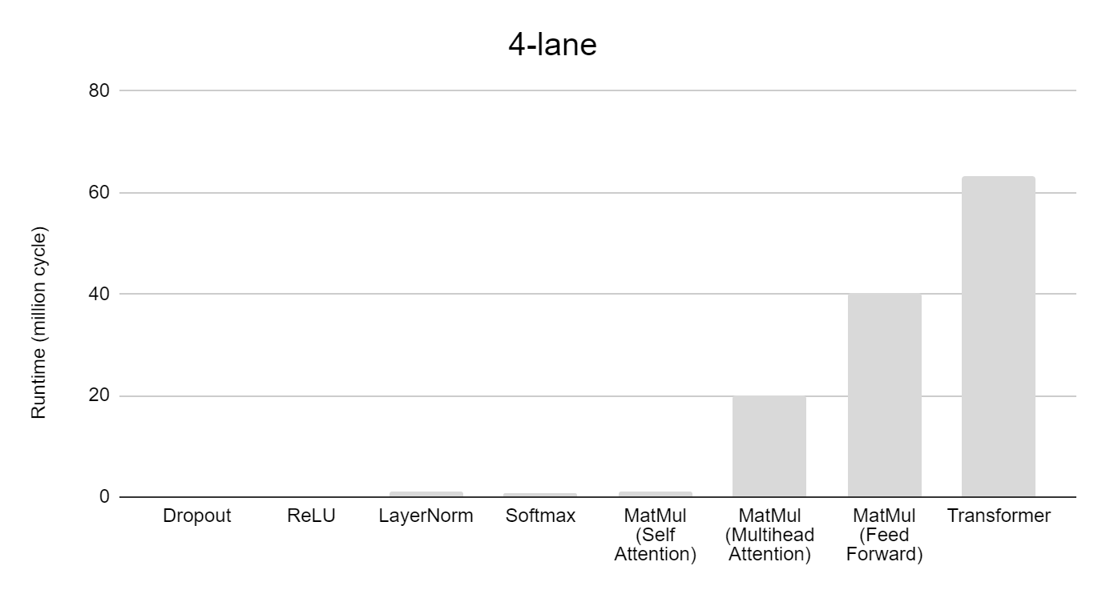
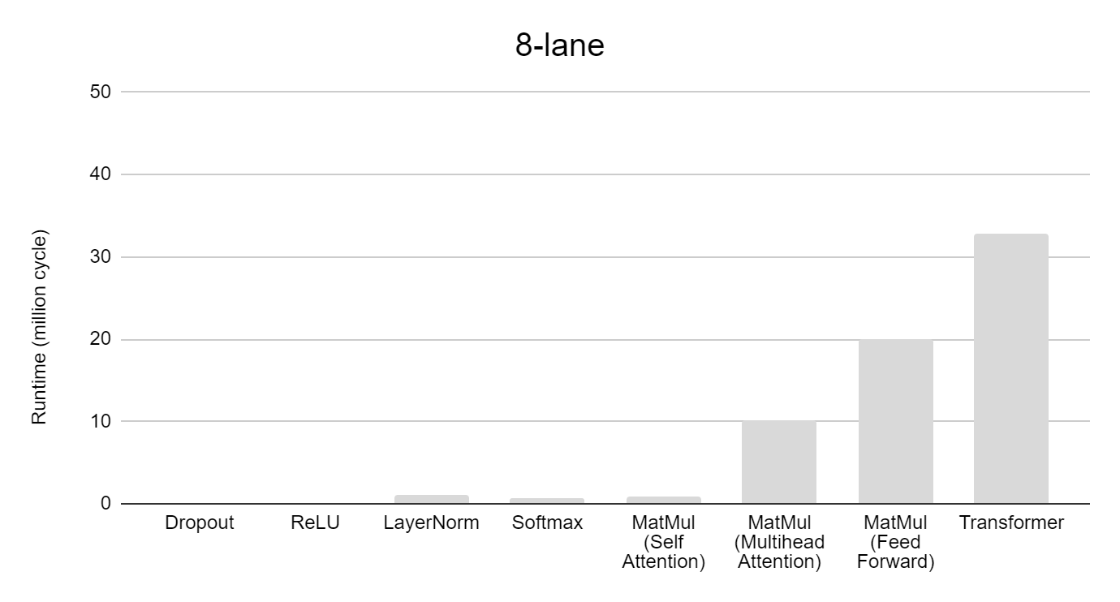
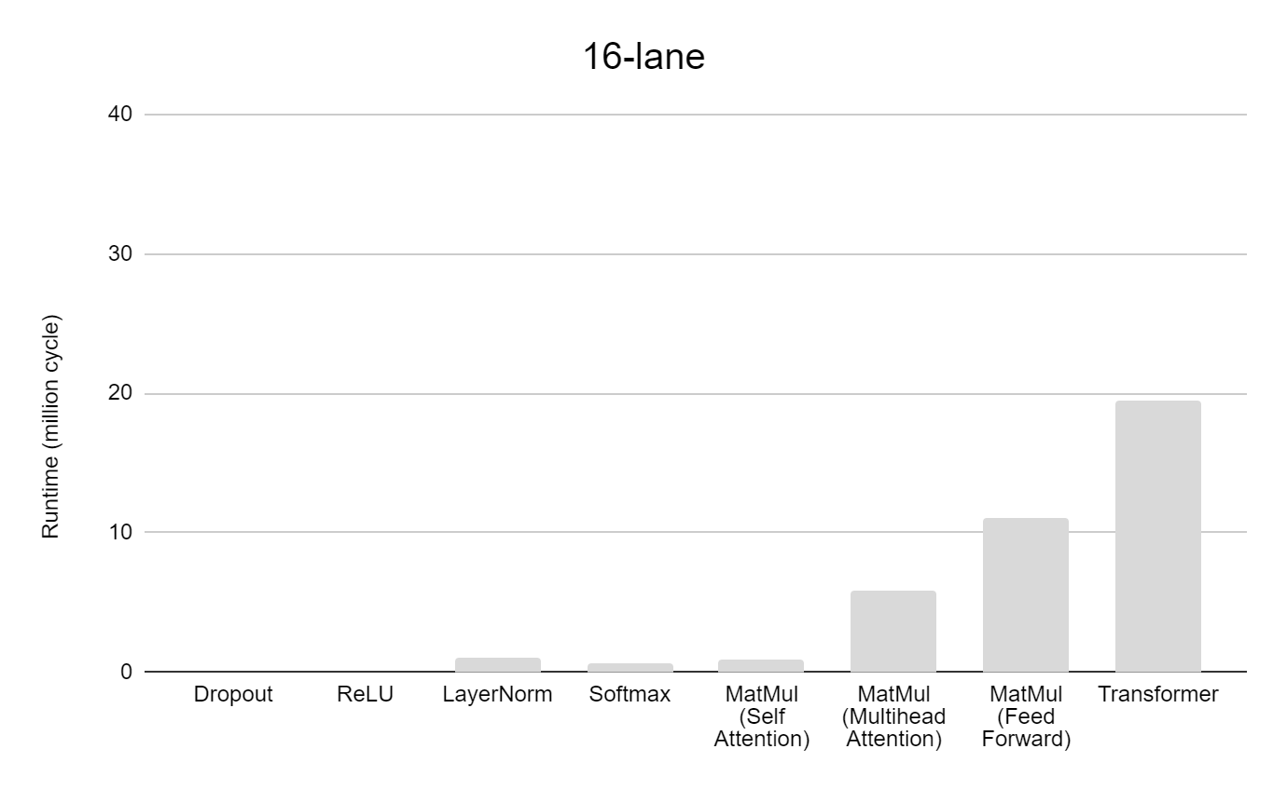
Runtime and Utilization
Runtime
FPU Utilization
91%
88%
94%
23%
24%
8%
22%
82%
94%
94%
23%
24%
4%
12%
60%
93%
E x H*P
768x768
Case I: Chaining
Wq
MatMul
Bias
S x E
64x768
Wk
MatMul
Bias
Transpose
x
MatMul
Bias
23%
24%
2%
6%
35%
74%
Wv
85%
80%
Introduction → Motivation → Background → Pre-Analysis → Implementation → Results → Conclusion

Slide 14
Runtime and Utilization
91%
83%
88%
94%
64%
82%
94%
94%
23%
24%
8%
22%
66%
23%
24%
4%
12%
60%
93%
34%
S x P
768x64
Case II: Decomposing
Wq(i)
MatMul
Bias
S x E
64x768
Wk(i)
MatMul
Bias
Transpose
x
Wv(i)
40%
23%
24%
2%
6%
35%
74%
MatMul
Bias
17%
85%
80%
Introduction → Motivation → Background → Pre-Analysis → Implementation → Results → Conclusion

Slide 15
Implementation
Improved MatMul Execution
Transpose the Transformer
Introduction → Motivation → Background → Pre-Analysis → Implementation → Results → Conclusion

Slide 16
Optimization 1: Improved MatMul with Reduced VL Sensitivity
vl=4
bl
b_vec 0
a
b_vec 0
Vanilla MatMul:
vl depends on P (vl <= P)
nr_lanes ↑ nr_elements in each lane ↓
→ utilization ↓
vl
a_vec
X
X
Matrix C
MxP
Matrix B
NxP
Matrix C
MxP
Matrix A
MxN
Matrix B
NxP
Matrix A
MxN
Improved MatMul:
Broadcast b_vec to all lanes
Each lane gets sufficient elements
Ara
lane 0
lane 0
lane 1
lane 1
# elements / lane = 4
# elements / lane = 2
Introduction → Motivation → Background → Pre-Analysis → Implementation → Results → Conclusion
Notes:
A new way of executing the MatMul

Slide 17
1. Load a_vec to VRF
reuse_size * nr_lanes
a_vec
vl = reuse_size * nr_lanes
Each lane allocates reuse_size(=2) elements
lane 0
lane 1
lane 2
lane 3
VRF
VRF
VRF
VRF
a0, a4
a1, a5
a2, a6
a3, a7
…
…
…
…
FPU
FPU
FPU
FPU
Introduction → Motivation → Background → Pre-Analysis → Implementation → Results → Conclusion

Slide 18
2. Load b_vec to bc_buffer
bl
b_vec
New instructions: vsetbl, vlebc
lane 0
lane 1
lane 2
lane 3
VRF
VRF
VRF
VRF
a0, a4
a1, a5
a2, a6
a3, a7
…
…
…
…
FPU
FPU
FPU
FPU
bc_buffer
b_vec
Introduction → Motivation → Background → Pre-Analysis → Implementation → Results → Conclusion

Slide 19
3. Broadcast elements in b_vec to all lanes
lane 0
lane 1
lane 2
lane 3
VRF
VRF
VRF
VRF
a0, a4
a1, a5
a2, a6
a3, a7
…
…
…
…
FPU
FPU
FPU
FPU
bc_buffer
b_vec
X Backend can be problematic, hard to scale
Introduction → Motivation → Background → Pre-Analysis → Implementation → Results → Conclusion

Slide 20
3. Send elements in b_vec to the first lane
: bc_operand_queue
lane 0
lane 1
lane 2
lane 3
VRF
VRF
VRF
VRF
a0, a4
a1, a5
a2, a6
a3, a7
…
…
…
…
FPU
FPU
FPU
FPU
1 clock cycle
bc_buffer
b_vec
Introduction → Motivation → Background → Pre-Analysis → Implementation → Results → Conclusion

Slide 21
4. Multiply a with b_vec
X
New instruction: vfbmacc (include step 3)
lane 0
lane 1
lane 2
lane 3
VRF
VRF
VRF
VRF
a0, a4
a1, a5
a2, a6
a3, a7
result 0
result 1
result 2
result 3
result 4
result 5
result 6
result 7
…
…
…
…
FPU
FPU
FPU
FPU
a4 * [b_vec] + ac
a7 * [b_vec] + ac
a0 * [b_vec] + ac
a5 * [b_vec] + ac
a1 * [b_vec] + ac
a6 * [b_vec] + ac
a2 * [b_vec] + ac
a3 * [b_vec] + ac
bc_buffer
b_vec
bl elements in each lane → vl = bl * nr_lanes
Introduction → Motivation → Background → Pre-Analysis → Implementation → Results → Conclusion

Slide 22
5. Store results in memory
New instruction: vssebc
lane 0
lane 1
lane 2
lane 3
VRF
VRF
VRF
VRF
a0, a4
a1, a5
a2, a6
a3, a7
result 0
result 1
result 2
result 3
result 4
result 5
result 6
result 7
…
…
…
…
FPU
FPU
FPU
FPU
VSTU
Support of new instructions:
LLVM Compiler
Spike ISA simulator
More efficient if storing the transposed matrix
(better memory bandwidth utilization)
Memory
Introduction → Motivation → Background → Pre-Analysis → Implementation → Results → Conclusion

Slide 23
Hardware: Broadcast Buffer
Ara
bc_buffer
lane 0
MEM
invalidate when finish
VRF
ADDRGEN
FIFO 0
write
read
…
…
VLDU
write
read
FIFO 1
FPU
2 * 32 * 32 bits
Introduction → Motivation → Background → Pre-Analysis → Implementation → Results → Conclusion
Notes:
hardware support 1: bc_buffer

Slide 24
Hardware: Broadcast Operand Queue
lane 1
Ara
lane 2
VRF
VRF
FIFO
Depth=2
…
…
…
…
bc_operand_queue
FPU
FPU
FPU delay
lane-lane delay
broadcast data
Introduction → Motivation → Background → Pre-Analysis → Implementation → Results → Conclusion
Notes:
hardware support 2: broadcast path

Slide 25
Optimization 2: Transpose the Transformer
Improved MatMul works better with transposed matrix
Softmax LayerNorm
columns → rows (contiguous address)
unit-stride memory ld/st (burst mode)
No negative effect on other kernels
Self-Attention
V(i)^T
Linear Algebra:
M2 = A x V
V^T x A^T = M2^T
Process transposed matrix
Q(i)^T
MatMul_t
M2(i)
MatMul_t_at
Softmax
Assume Input is transposed
A^T
K(i)^T
Matrix A is transposed (Q(i)^T)
Introduction → Motivation → Background → Pre-Analysis → Implementation → Results → Conclusion

Slide 26
Results
Performance Improvement
Backend Results
Energy Efficiency Improvement
Introduction → Motivation → Background → Pre-Analysis → Implementation → Results → Conclusion

Slide 27
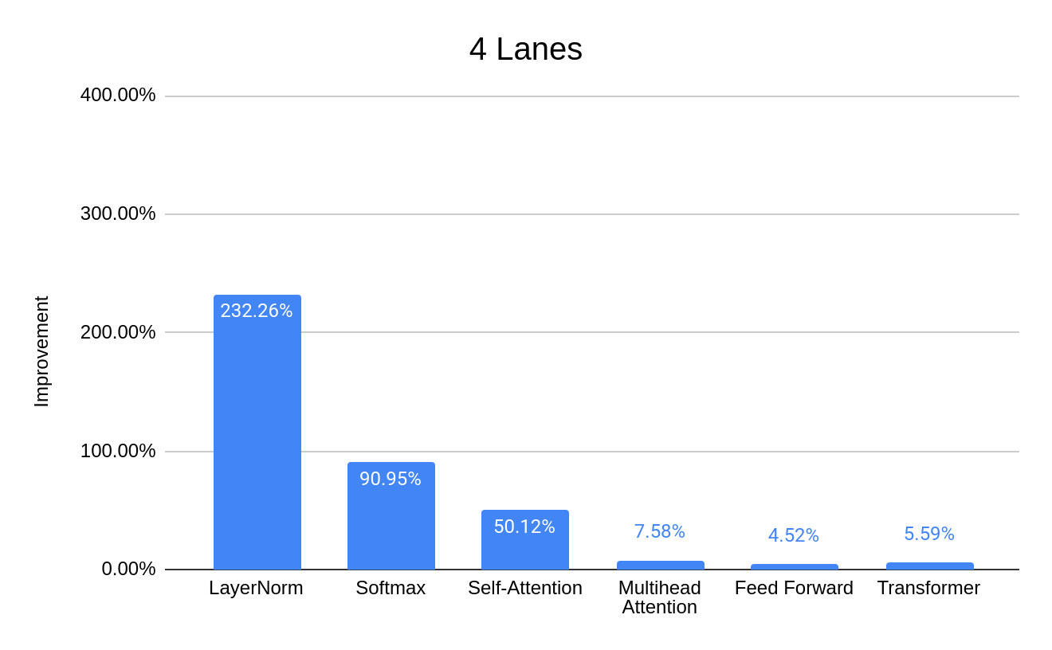
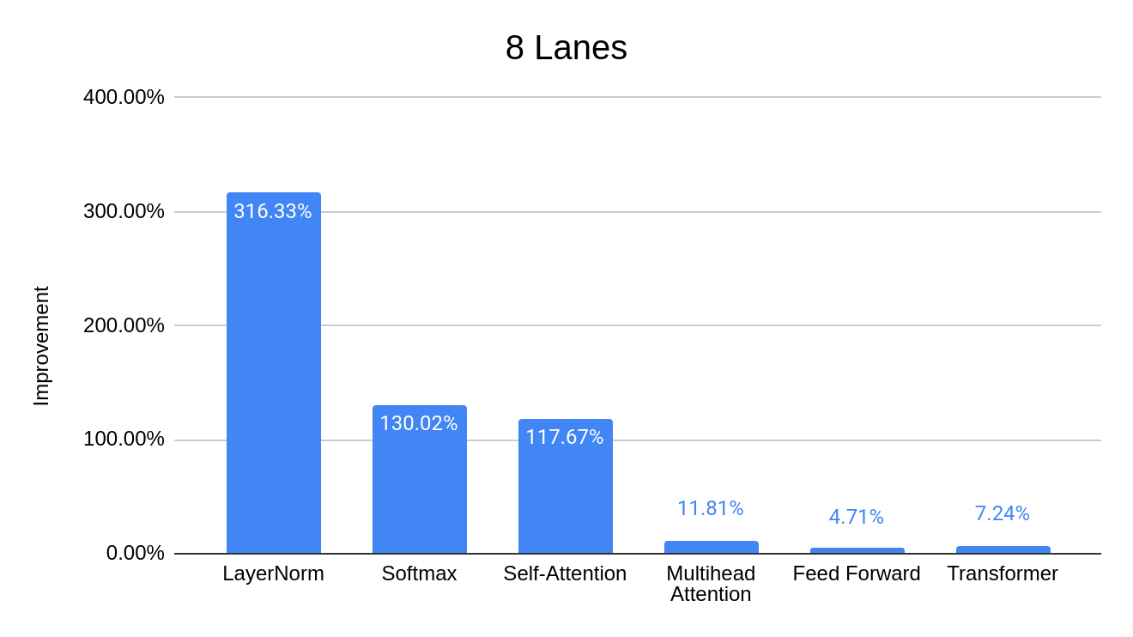
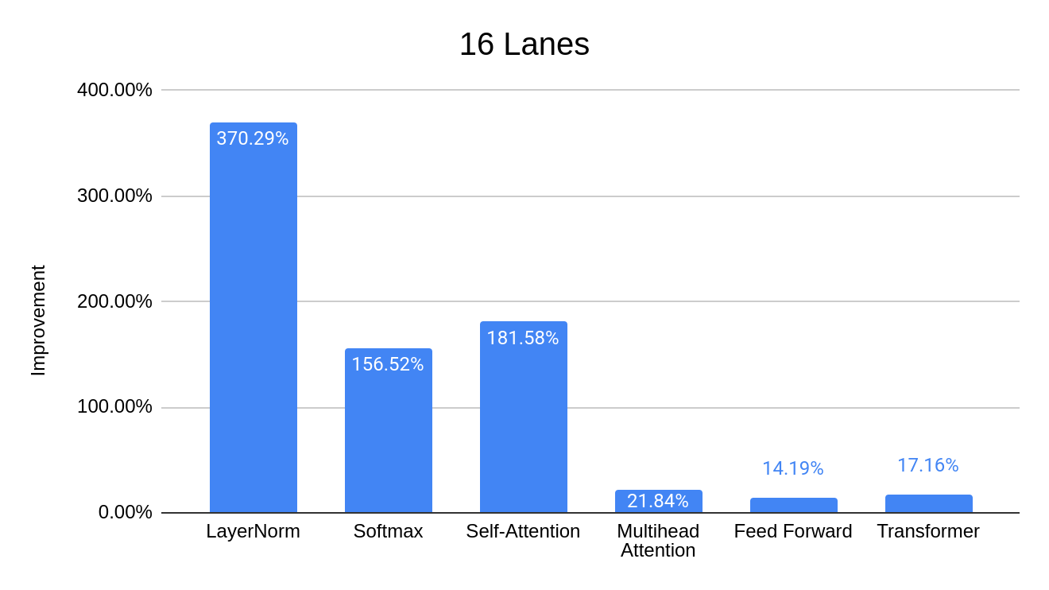
Performance Improvement: Transformer
E x H*P
768x768
Case I: Chaining
Wq
MatMul
Bias
S x E
64x768
Wk
MatMul
Bias
Transpose
x
MatMul
Bias
Wv
Introduction → Motivation → Background → Pre-Analysis → Implementation → Results → Conclusion
Notes:
Performance Improvement 1 Each kernel
MatMul

Slide 28
Performance Improvement: Transformer
139%
40%
49%
17%
S x P
768x64
Case II: Decomposing
Wq(i)
MatMul
Bias
319%
S x E
64x768
Wk(i)
MatMul
Bias
Transpose
x
125%
Wv(i)
MatMul
Bias
Introduction → Motivation → Background → Pre-Analysis → Implementation → Results → Conclusion
Notes:
Performance Improvement 1 Each kernel
MatMul

Slide 29
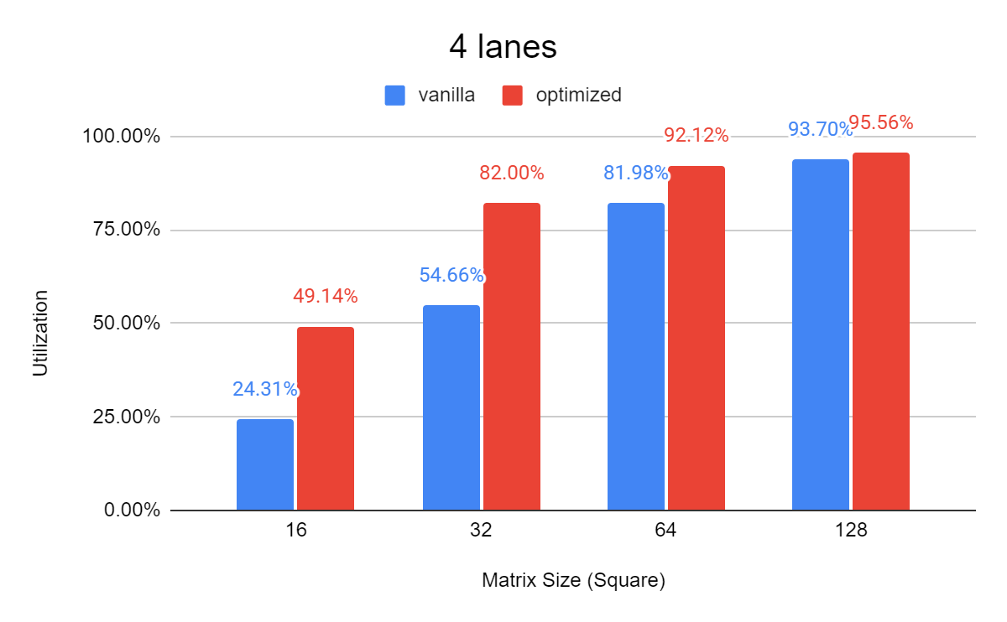
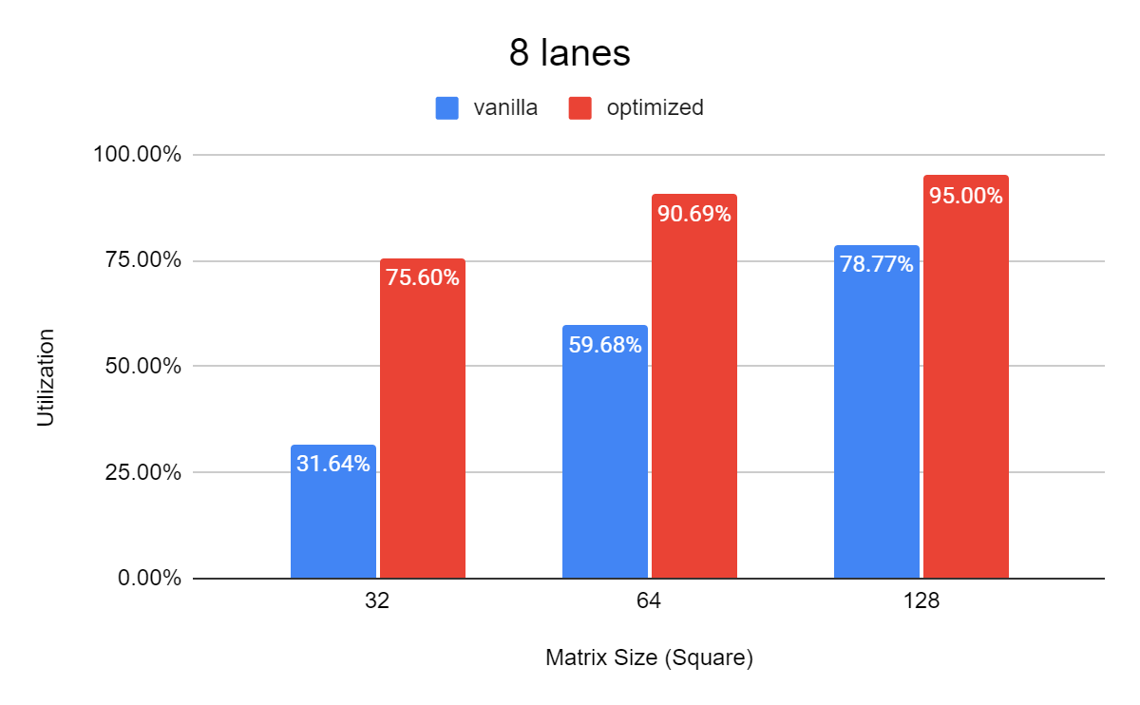
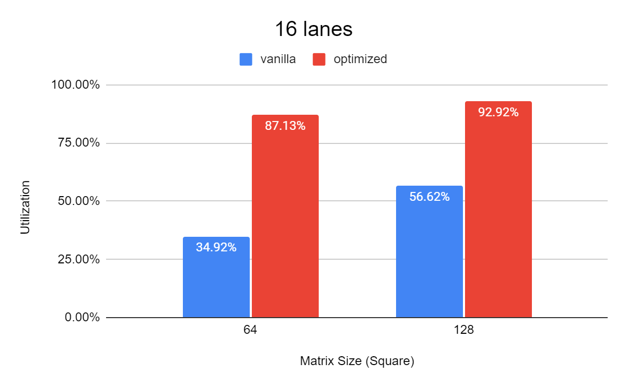
Performance Improvement: Small MatMul
2.4x
2x
Currently does not support arbitrary dimensions
2.5x
Introduction → Motivation → Background → Pre-Analysis → Implementation → Results → Conclusion

Slide 30
Physical Design
Technology: GlobalFoundries 22FDX FD-SOI
Target Frequency: 1GHz
Synthesis: Synopsys Design Compiler; P&R: Synopsys IC Compiler II
4-lane & 8-lane
Floorplan optimization
BC_BUFFER
BC_BUFFER
L2
L3
L0
L3
L0
L1
L1
L2
Critical path
Introduction → Motivation → Background → Pre-Analysis → Implementation → Results → Conclusion
Notes:
Floorplan optimization, flat mode

Slide 31
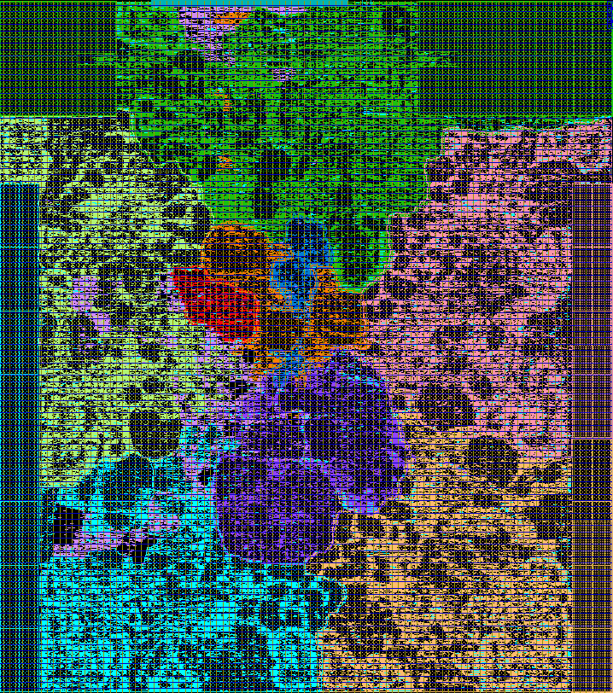
Backend Result
I$
D$
CVA6
4-lane | TT freq (GHz) | SS freq (MHz) | Area Utilization | Die Area (mm²)
Vanilla | 1.34 | 967 | 79.10% | 0.87
Modified | 1.33 | 949 | 82.49%
Change | -0.7% | -1.8% | +3.4%
dispatcher
sequencer
bc_buffer
lane 3
lane 0
vlsu
8-lane | TT freq (GHz) | SS freq (MHz) | Area Utilization | Die Area (mm²)
Vanilla | 1.37 | 943 | 69.94% | 1.88
Modified | 1.28 | 903 | 72.53%
Change | -7.8% | -4.2% | +3.1%
masku
sldu
lane 1
lane 2
Delay caused by hold-time buffers
Introduction → Motivation → Background → Pre-Analysis → Implementation → Results → Conclusion
Notes:
Backend TC: 1GHz, WC: Area

Slide 32
Power Results
Estimate the transformer power by a small segment of MatMul (64x768x768)
Represent > 95%
4-lane | P_dyn (mW) | P_st (mW) | P_tot (mW) | Throughput (SP-GFLOPS) | Efficiency (SP-GFLOPS/W) | Improvement
Vanilla (1.34GHz) | 257 | 10 | 267 | 19.55 | 73.22 | 10.21%
Modified (1.33GHz) | 243 | 11 | 254 | 20.50 | 80.70
8-lane | P_dyn (mW) | P_st (mW) | P_tot (mW) | Throughput (SP-GFLOPS) | Efficiency (SP-GFLOPS/W) | Improvement
Vanilla (1.37GHz) | 508 | 26 | 534 | 38.50 | 72.08 | 11.54%
Modified (1.28GHz) | 453 | 27 | 480 | 38.59 | 80.40
Introduction → Motivation → Background → Pre-Analysis → Implementation → Results → Conclusion

Slide 33
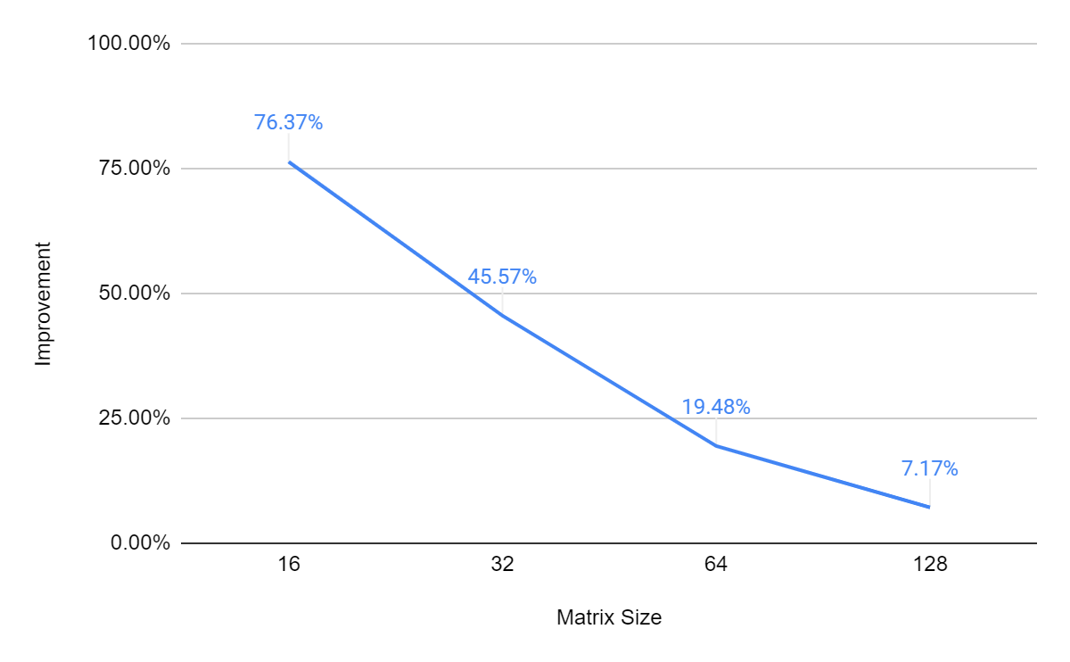
Efficiency Results: Small MatMul
MatMul Improvement (SP-GOPS/W)
TT frequency
4-lane
Introduction → Motivation → Background → Pre-Analysis → Implementation → Results → Conclusion
Notes:
Power Estimation Transformer FLOPS/W different MatMul

Slide 34
Conclusion
Implement and optimize transformers on Ara
Performance: 4-lane → 16-lane
(chained) 5% → 17%
(decomposed): 17% → 125%
Energy Efficiency:
+10% (4-lane) → +11%(8-lane)
Improved small MatMul (new instructions, hardware)
Performance: up to 2.5x higher utilization
Energy Efficiency: +7% → +76%
Introduction → Motivation → Background → Pre-Analysis → Implementation → Results → Conclusion
Notes:
Conclusion Future Work

Slide 35
Future Work
New MatMul
Transformer
Support for arbitrary matrix sizes
Further improve utilization
Other applications: CNN …
Deploy a more appropriate model (smaller, lightweight)
Explore sparsity, low data precision
Introduction → Motivation → Background → Pre-Analysis → Implementation → Results → Conclusion

Slide 36
END

Slide 37
Transformer Accelerator
Systolic Array
Reuse data across one row/column
In-Memory-Computing
Performance
Transformer is mainly composed of MatMul
Specialized Accelerators
Best performance for a specific task/model
Lack of flexibility
DNNs evolve rapidly!
Supercomputer: Fugaku
Scalable Vector Extension (SVE)
Vector Processor
Parallel computing, SIMD
Popular in supercomputing
Ara + CVA6: RISC-V Vector Extension 1.0
Scalable: # lanes, multi-core
Flexibility
Introduction → Motivation → Background → Pre-Analysis → Implementation → Results → Conclusion
1. Efficient Systolic-Array Redundancy Architecture for Offline/Online Repair
2. ReTransformer 3.https://www.engadget.com/japan-fugaku-supercomputer-013121699.html 4. FS community What Is a Server CPU?

Slide 38
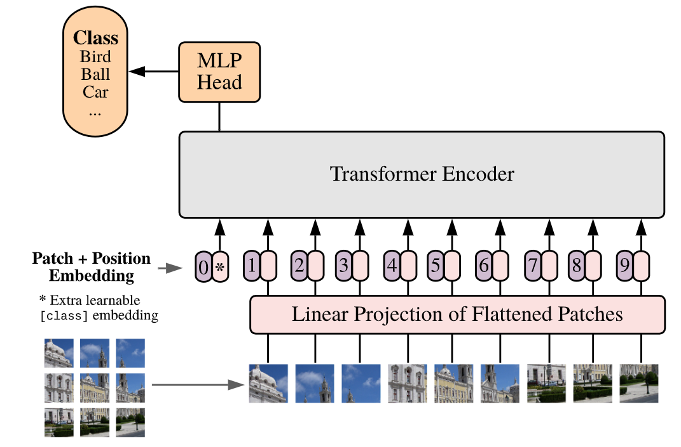
Image processing in transformer

Slide 39
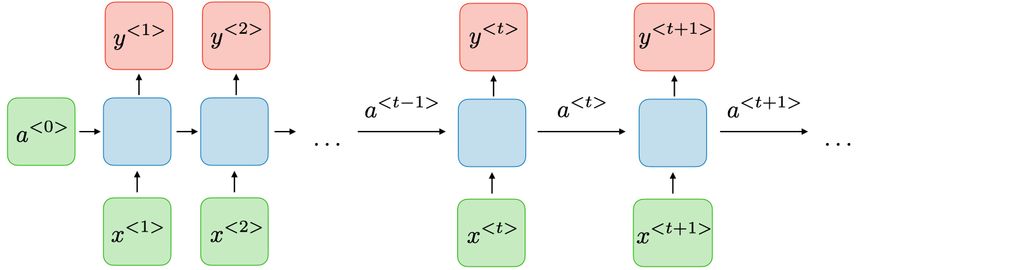
RNN vs Transformers
RNN: y<t> depends on a<0>, …, a<t-1>
Vanishing gradient (chain rule)
Example:
I am a student at ETH. (Cryptocurrency ?)
Struggle to extract long-term dependencies
Transformers: all tokens are equidistant
Parallel processing
Effectively handle long-term dependencies
Add positional encoding to the input tokens

Slide 40
Runtime Distribution
Transformer
Multihead Attention
Feed Forward
35.5%
64.5%
63,176,959 clock cycles
MatMul
Self-Attention x 12
MatMul
Multihead Attention
Feed Forward
89.6%
8.0%
98.4%
LayerNorm+Dropout 2.4%
LayerNorm+ReLU+Dropout 1.6%
MatMul > 95%
MatMul
Softmax
Self-Attention
60%
40%

Slide 41
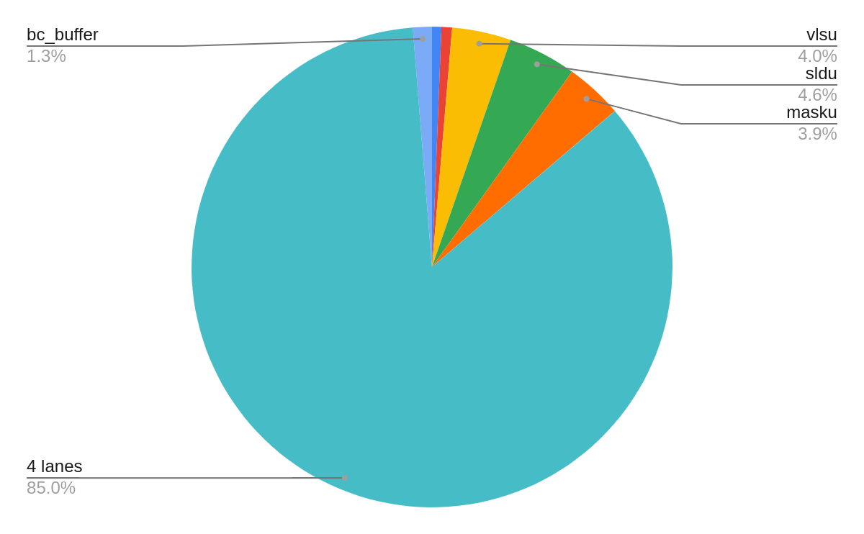
Backend Result
Area:
Cell area utilization: 79.10% → 82.49% (3.39% ↑)
vector unit 100%
Notes:
Backend TC: 1GHz, WC: Area

Slide 42
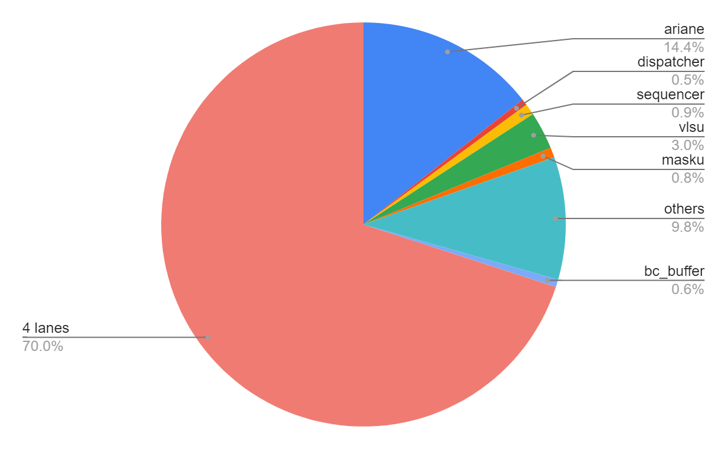
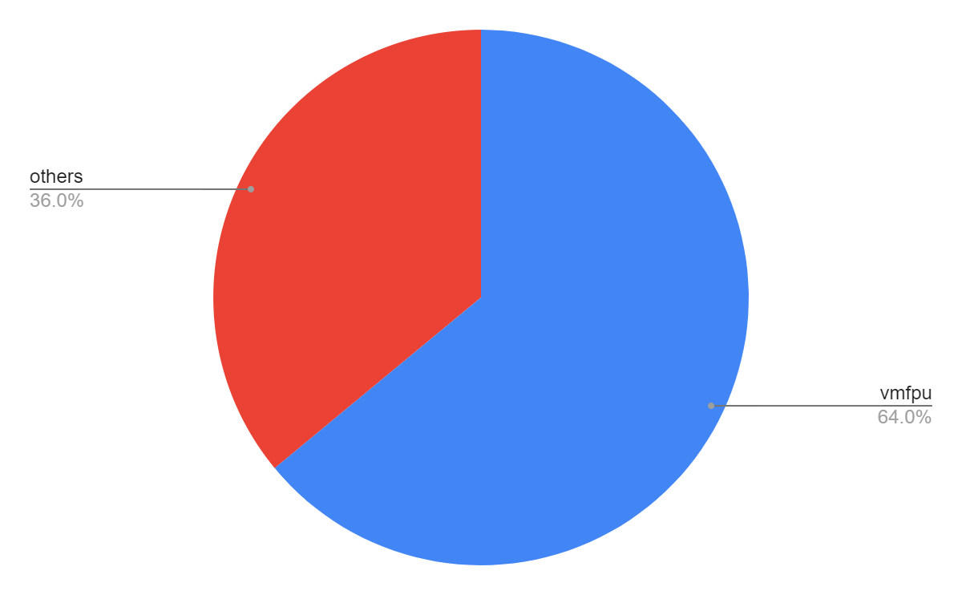
Power Results
5.27%
Notes:
Power Estimation Transformer FLOPS/W different MatMul

Slide 43


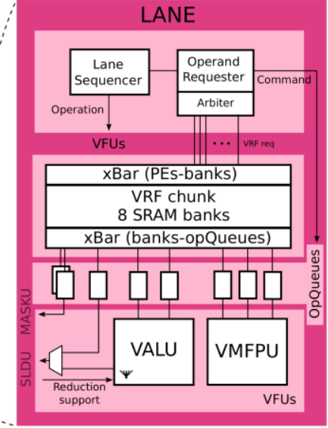
Critical Path 4-lane
Vanilla (-34ps)
Modified (-52ps)

Slide 44
Critical Path 8-lane
Vanilla (-60ps)
Modified (-86ps)
spill_reg in toplevel
axi_req_o

Slide 45
Power Results
Estimate the transformer power by a small segment of MatMul (64x768x768)
Represent > 95%
 | int (mW) | switch (mW) | leak (mW) | total (mW) | SP-GFLOPS/W | Improvement
Vanilla | 120 | 72 | 10 | 202 | 72.22 | 7.70%
Modified | 110 | 73 | 11 | 198 | 77.78
4-lane
 | int (mW) | switch (mW) | leak (mW) | total (mW) | SP-GFLOPS/W | Improvement
Vanilla | 218 | 153 | 26 | 397 | 70.80 | 13.87%
Modified | 204 | 150 | 27 | 381 | 80.62
8-lane
Introduction → Motivation → Background → Pre-Analysis → Implementation → Results → Conclusion
Notes:
Power Estimation Transformer FLOPS/W different MatMul

Slide 46
Comparison with SOTA
 | ISSCC’22-29.3 | 1 | ISSCC’22-29.2 | 2 | 3 | This Work
Technology | 28nm | 5nm | 28nm | 40nm | 40nm | 22nm
Data Precision | INT8, INT16 | INT8 | INT12 | INT8, FP16 | INT9 | FP32
Peak Performance (TFLOPS/TOPS) | 1.48 ~ 0.37 | 1.8 | 0.52~4.07 | 1.09 | 0.22 | 0.055 (avg)
Energy Efficiency (TFLOPS/W TOPS/W) | 20.5 ~ 5.1 | 39.1 | 1.91~27.56 | 1.12 | 1.99 | 0.08
A 17–95.6 TOPS/W Deep Learning Inference Accelerator with Per-Vector Scaled 4-bit Quantization for Transformers in 5nm
Accelerating Attention Mechanisms in Neural Networks with Approximation
ELSA: Hardware-Software Co-design for Efficient, Lightweight Self- Attention Mechanism in Neural Networks

